Slide 1
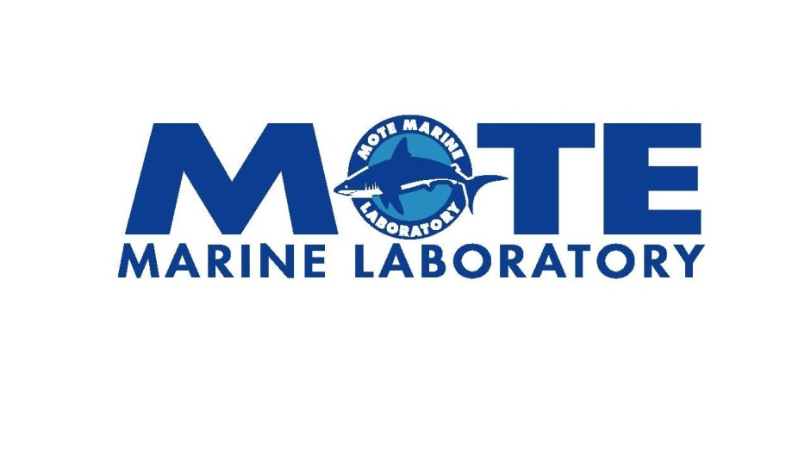

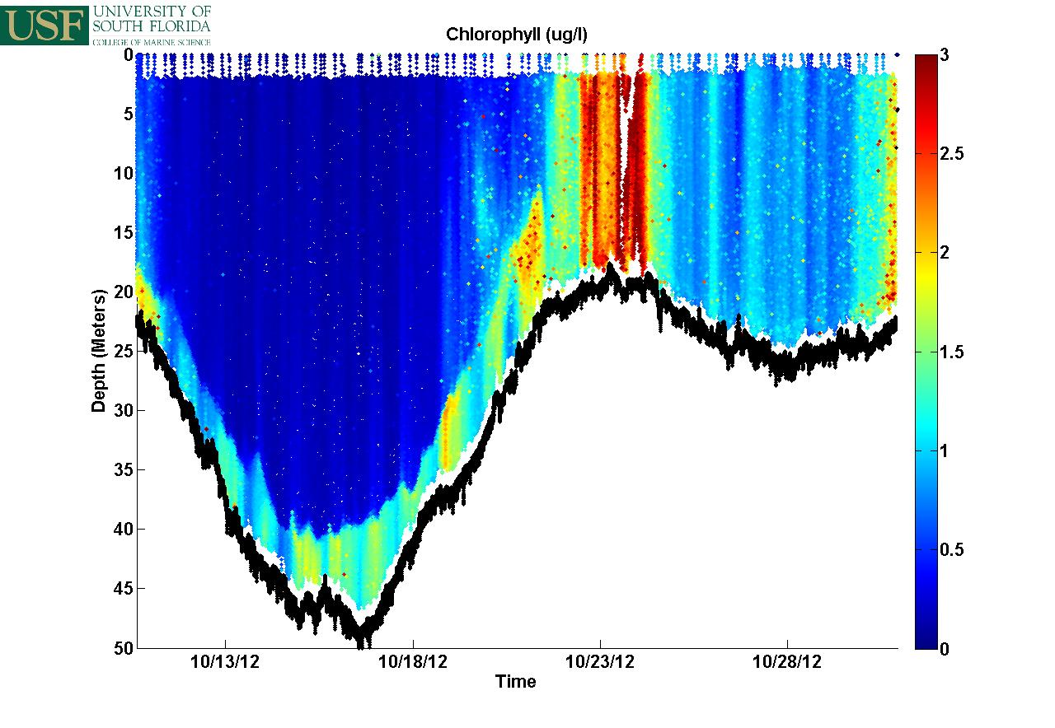
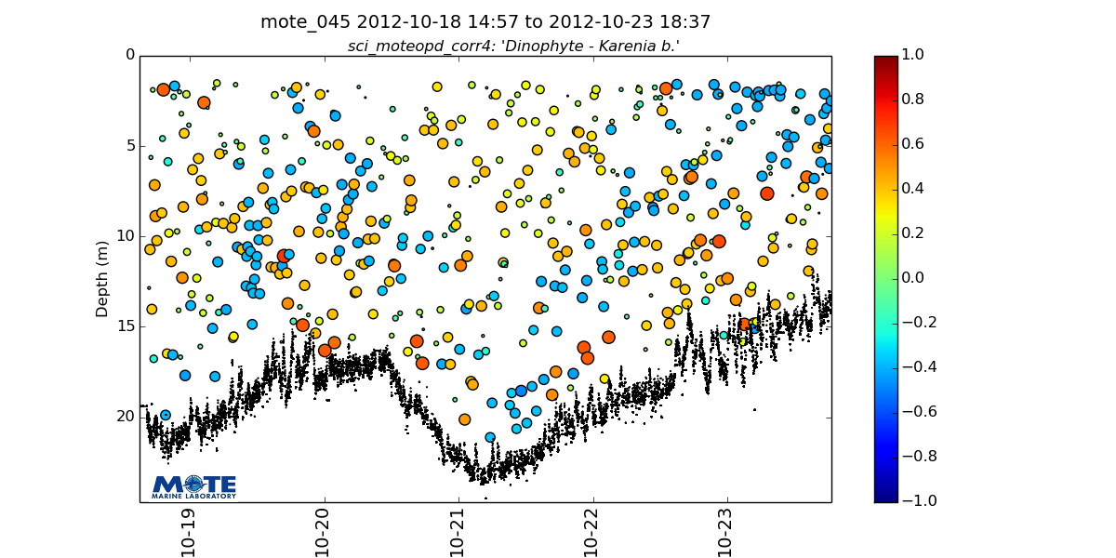
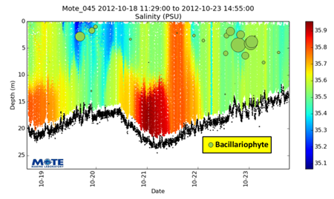
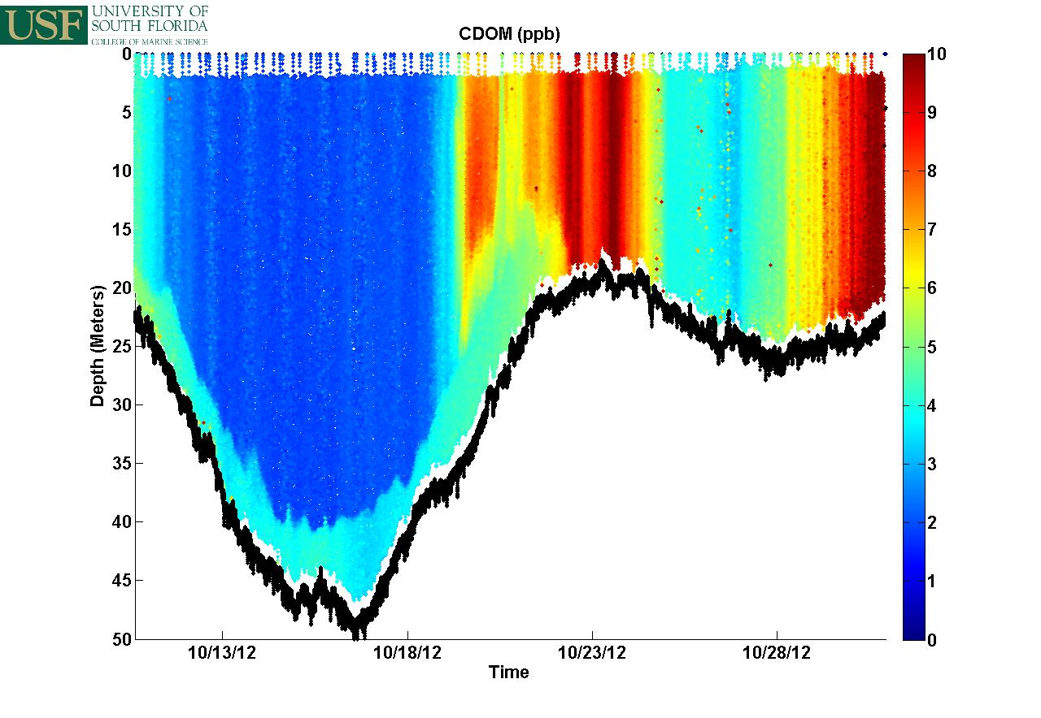
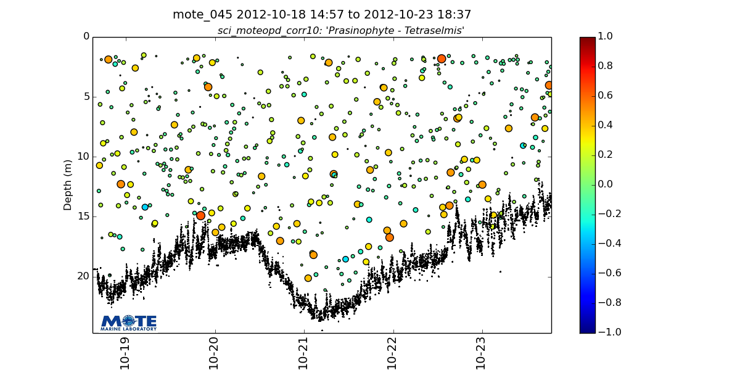
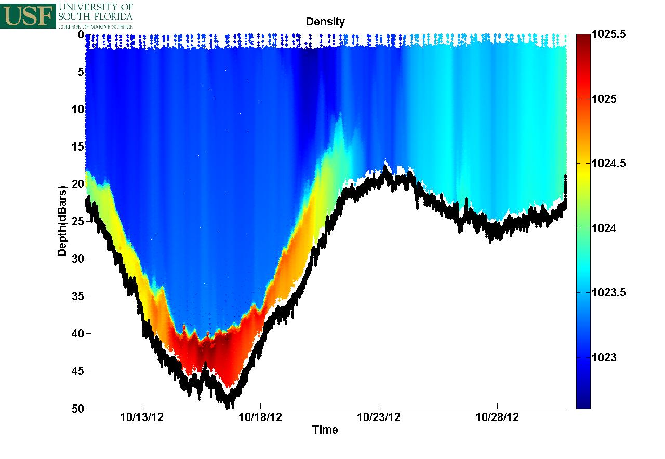

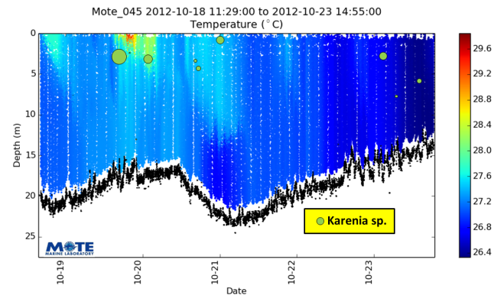

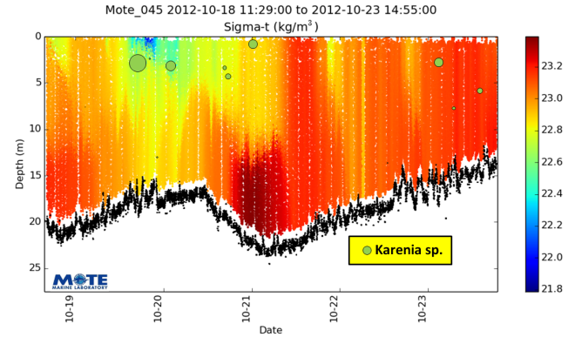
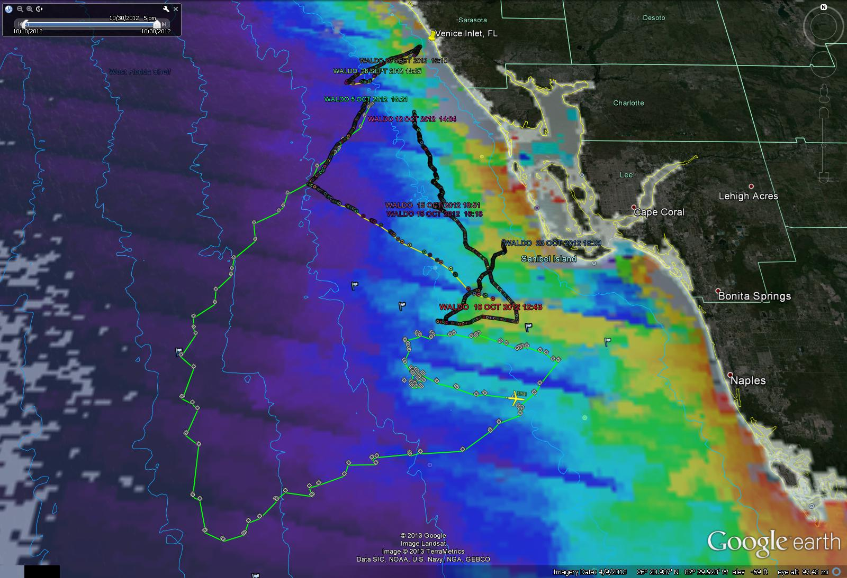
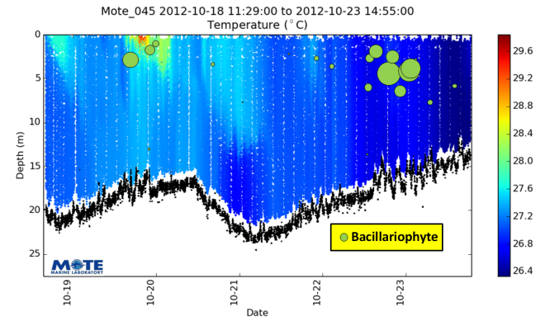


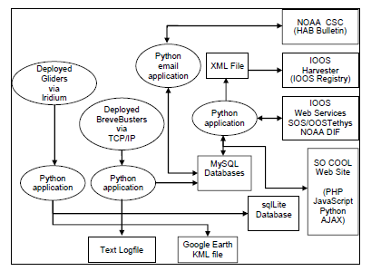
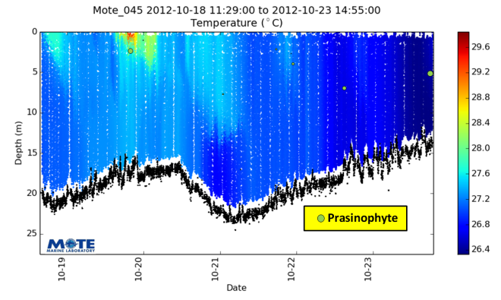





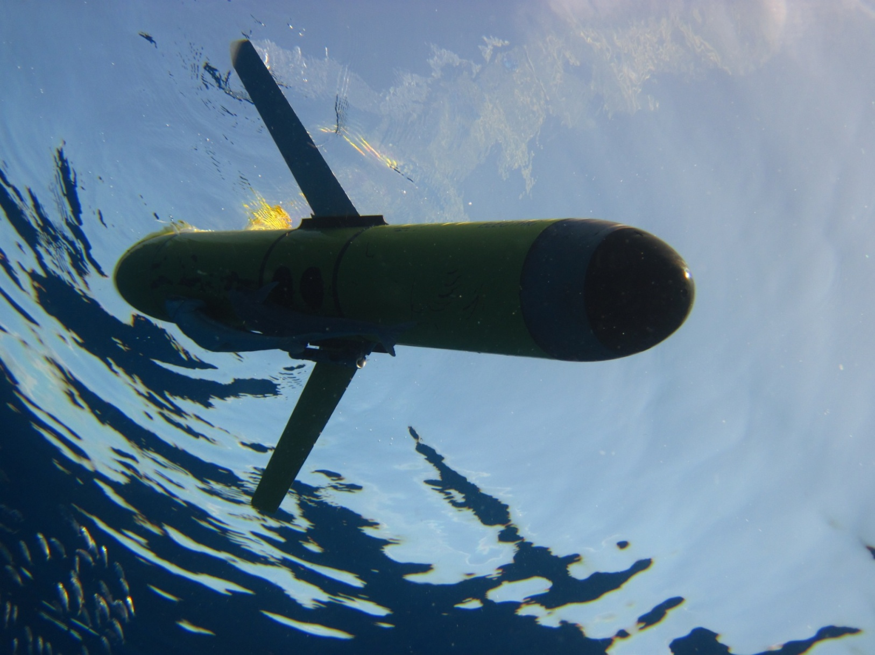

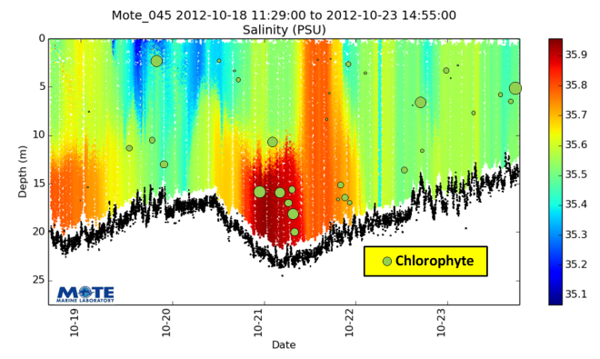

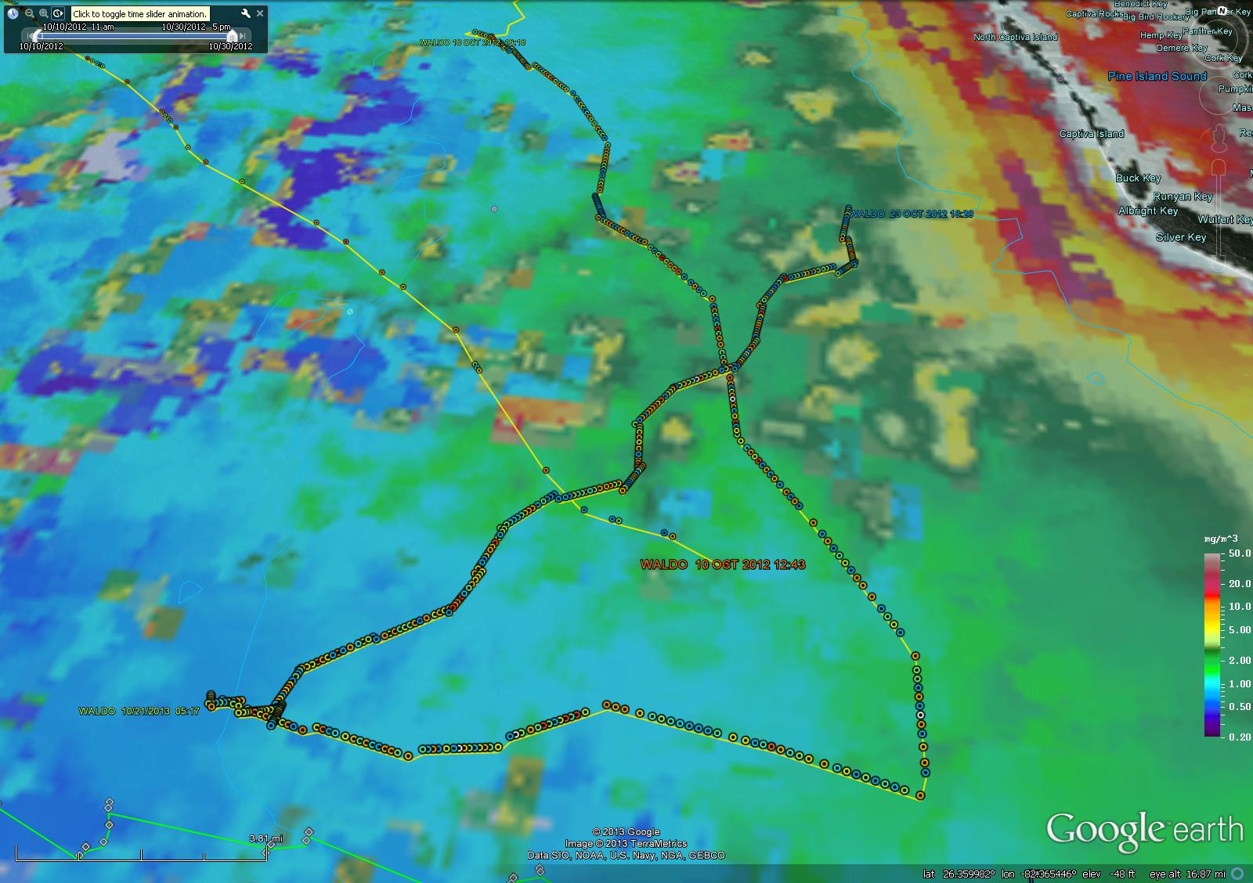




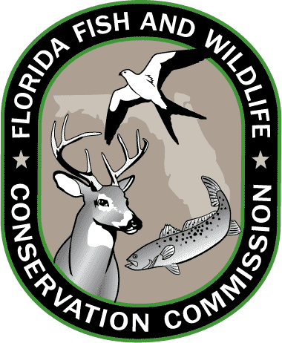



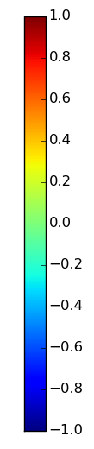



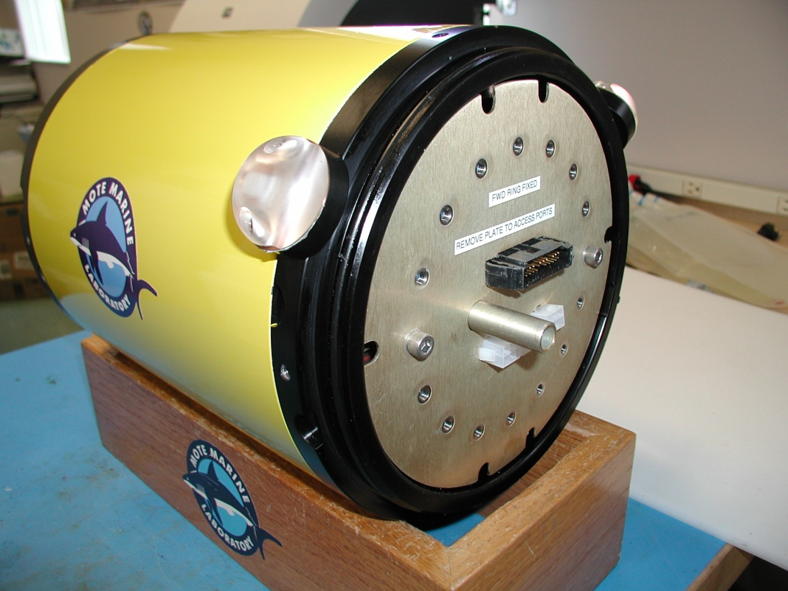
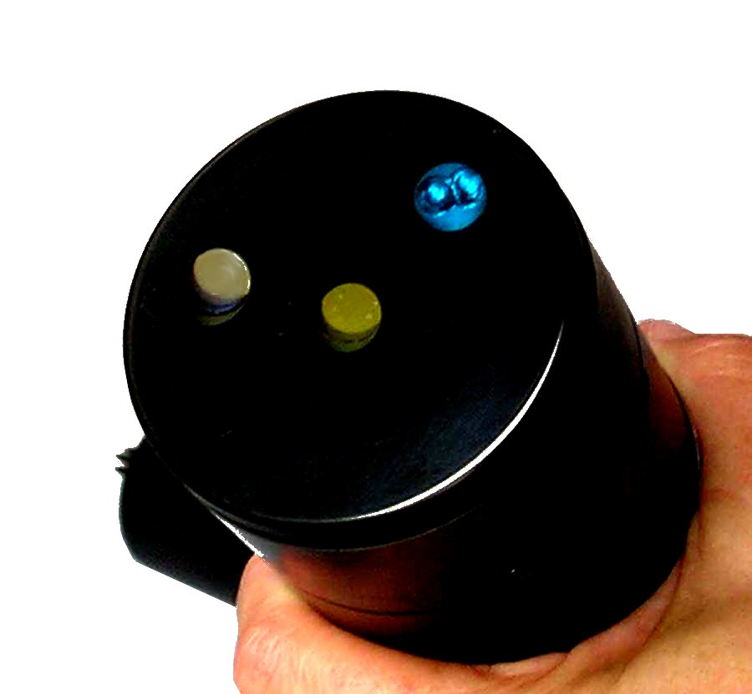
SUCCESSFUL OCEAN OBSERVATORIES AT WORK ON A HARMFUL ALGAL BLOOM ON THE WEST FLORIDA SHELF
Alan Hails¹, Gary Kirkpatrick¹, Chad Lembke², Robert Currier¹, L. Kellie Dixon¹
¹Mote Marine Laboratory, 1600 Ken Thompson Parkway, Sarasota, FL 34236, USA
²University of South Florida, 140 7th Avenue South, St. Petersburg, FL 33701, USA
INTRODUCTION
NEAR-REALTIME DATA
POST-PROCESSED ANALYTICAL RESULTS
CONCLUSIONS
In October, 2012, during an evolving Red Tide bloom event, Mote Marine Laboratory (Mote) and University of Southwest Florida (USF) deployed multiple instruments and ocean platforms to gather data needed to characterize and study it. The GCOOS portion of the project had the additional objective of demonstrating real-time telemetering of multiple AUV and sensor data to the GCOOS data servers where visualizations of AUV data fused with satellite imagery and ocean models could be produced.
During the period from October 5 through October 23, 2012 the AUV Waldo operated by Mote and the AUV Bass, operated by USF, were concurrently “flown” through an area 15 nm offshore of Englewood, Florida to 50 nm offshore of Naples, Florida. Within that area a concentrated data collection effort took place 5-11 nm SW of Sanibel Island. Also concurrently, under other programs sponsored by FWC, manned surface research vessels were deployed by Mote on October 4, 9, and 10.
We describe the many resources employed during this event, the numerous types of data collected and how they were combined and compared to learn about the origins, 3-D location and progression and strength of the bloom, and how the data was ported to the Gulf regional observatory for presentation and sharing in real-time.
Summarized data from CTDs, the OPD , optical sensors for chlorophyll, CDOM, and backscatter, and oxygen and irradiance sensors were telemetered to shore servers at each glider’s surfacing – typically every 2 hours . Some examples are depicted below.
Taxonomic classes, estimated by the OPD, overlain on water structure cross-sections for the glider mission from October 18 to October 23, 2012. The diameter of the circles is related to the chlorophyll a biomass of the taxonomic class. Non-parametric, multidimensional analysis found a small (0.246), but significant (p<0.001), correlation between the observed community taxonomic patterns and bottom depth, sample depth and water temperature.
Satellite remote sensing, such as Fluorescence Line height, is very useful in its ability to help locate high chlorophyll levels at the ocean surface, but can be misleading about the rest of the water column. Profiling instruments are needed to reveal the much greater detail of species identification and location in 3-space, along with other ocean environmental structural data.
Glider and OPD results provided a picture of Karenia distributions that was not obtainable by discrete sampling from shipboard or from remote sensing. Water column physical structure was demonstrably complex and likely played a role in the aggregation behavior of Karenia and other species of the community.
The data collected during the glider missions showed a strong thermocline coupled with upwelling along the bottom in regions outside of the surface bloom area. On its southern transect, this stratification can be seen to disappear at the 20m isobath in the region where the surface bloom was detected within the satellite images. The gliders encountered well mixed areas for the remainder of the deployment.
Mission data from Mote was disseminated to USF and GCOOS through the GliderTracker generated KML file. The KML file was regularly harvested by GCOOS software and ingested into the GCOOS data portal for immediate display. Mission data from USF’s Bass glider was made available to GCOOS and Mote through USF’s web portal. Data was supplied as tab-delimited text files generated from the glider’s binary SBD and TBD files. The text files were harvested by GCOOS and ingested into the GCOOS data portal.
Phytoplankton similarity indexes (SI), below: The SI represent
the fraction of the phytoplankton biomass that is made
up of the target species
MOTE SIM. INDEX COLOR SCALE
EQUIPMENT, METHODS
The Mote autonomous underwater vehicle (AUV) , Waldo, was equipped with a flow-thru CTD and the Mote-developed Optical Phytoplankton Discriminator instrument. The OPD is a mobile water sampling spectrophotometer employed to quantify various species of the Gulf phytoplankton community, including red tide. The USF AUV , Bass, was equipped with a similar CTD as well as with fluorometric sensors for chlorophyll, CDOM, &backscatter, and with sensors for dissolved oxygen and irradiance. Surface vessels took CTD measurements and obtained water samples returned to the lab for HPLC analysis of toxins and pigments and for direct cells/liter measurements of red tide. Ashore, remote imagery data and ocean model predictions were produced to guide the data collection efforts.
Data from Mote’s AUV was ingested into the SO COOL data processing center via a RUDICS Iridium connection. Initial processing and archiving was handled by Teledyne-Webb Research’s ‘dockserver’ and ‘dataserver’ applications. Incoming files were processed in near real-time and made visible to glider operators and scientists through the ‘Data Visualizer’ tool.
Spatial representation of Similarity Index (SI) of Karenia brevis, October 4-25, 2012.
SI greater than 0.6 indicate K. brevis. Also plotted is the track of USF glider Bass.
MOTE SOCOOL
MISSION DATA
FLOW
DIAGRAM
ACKNOWLEDGEMENTS
Zoomed spatial representation of Similarity Index (SI) of Karenia brevis, October 18-25, 2012.
SI greater than 0.6 indicate K. brevis.
The autonomous underwater vehicle (AUV) portion of the resources for this collaborative project was sponsored by the Gulf of Mexico Coastal Ocean Observing System (GCOOS) and State of Florida Fish and Wildlife Conservation Commission (FWC).
A glider equipped with an OPD payload was deployed in multiple discrete deployments throughout the fall during the height of the 2012-2013 bloom. Beginning in July, 2012, three deployments were conducted under GCOOS funding with portions of two more deployments partially supported. (The two partially supported deployments also received support from GCOOS to conduct joint glider operations with USF [NOAA Award NA08NOS4730411, Sub award 99S120306].) Another complementary two missions were completed with funding from the State of Florida in a cooperative effort with the Florida Wildlife Research Institute.
OPD SIMILARITY
INDEX COLOR MAP
REFERENCES
CHL-A
COLOR
MAP

